Slide 1
Cloud-native applications

Slide 2

Abstract and learning objectives
Abstract
This whiteboard design session is designed to help attendees understand the choices related to building and deploying containerized applications in Azure, critical decisions around this and other aspects of the solution including ways to lift-and-shift parts of the application to reduce applications changes.
Learning objectives
Work with Docker images and Azure Container Registry
Create a Kubernetes cluster with Azure Kubernetes Service (AKS)
Deploy containers to a Kubernetes cluster
Load balance containers, set up dynamic service discovery
Scale services
Perform rolling upgrades with zero downtime

Slide 3
Step 1: Review the customer case study
Outcome
Analyze your customer needs.
Timeframe
15 minutes

Slide 4
Customer situation
Fabrikam Medical Conferences provides conference web site services tailored to the medical community.
After starting with a few small conferences, they now have evolved into a well-known brand and handle over 100 conferences per year and growing.

Slide 5
Customer situation 2
Each conference site has limited budget, but the conference owners have significant customization and change demands.
These changes can impact various aspects of the system from UI to back end, including conference registration and payment terms.

Slide 6
Customer situation 3
12 developers handle:
Development
Testing
Deployment
Operational management of all customer sites
Due to customer demands, they have issues with the efficiency and reliability of their development and DevOps workflows.

Slide 7
Customer situation 4
The technology used is the MEAN stack
Mongo, Express, Angular, and Node.js
Web sites and APIs are built as microservices hosted on Linux servers.
The on-prem data backend is MongoDB; also running on a separate cluster of Linux servers.
There is relational data stored in PostgreSQL running on Linux servers.

Slide 8
Customer situation 5
Conference owners (“customers”) are considered “tenants”, and each tenant is treated as a unique deployment including:
Each tenant has a database in the MongoDB cluster with its own collections, and a database in PostgreSQL.
A copy of the most recent functional conference code base is taken and configured to point at the tenant database
Modifications are made to support the customer’s needs
The tenant’s code is deployed to a specific group of load balanced Linux server dedicated to one or more tenant.
Once the conference site is live, the inevitable requests for customizations to the deployment begins.

Slide 9

Customer situation 6
They are looking to achieve the following:
Reduce potential regressions introduced to functional tenant code when changes are made
Ideally, changes to individual areas should not require a full regression test of the site functionality
Reduce the time to onboard new tenants
Reduce overhead managing changes, and related deployments
Improve ability to roll back and recover post change
Increase visibility into system operations and health

Slide 10
Customer needs
Simplify new tenant deployment
Improve reliability of tenant updates
Choose a suitable Docker container strategy on Azure
Migrate MongoDB data to Cosmos DB without application changes
Migrate relational data from PostgreSQL on-premises databases to Microsoft Azure
Continue to use Git repositories for source control
Look at GitHub Actions as the CICD tool of choice

Slide 11
Customer needs (continued)
Use tools for deployment, CICD integration, container scheduling, orchestration, monitoring, and alerts
They wish to complete an implementation of the proposed solution for a single tenant to train the team and perfect the process
Enhance attendee session feedback with AI to prevent inappropriate content from being posted, and real-time language translation to better accommodate growing worldwide conference attendance.

Slide 12

Customer objections
There are many ways to deploy Docker containers on Azure, how do those options compare and what are motivations for each?
Is there an option in Azure that provides container orchestration platform features that are easy to manage and migrate to, that can also handle our scale and management workflow requirements?
We heard Azure Cosmos DB is compatible with MongoDB. Will this provide a migration that minimizes code changes?
We know Microsoft offers Cognitive Services with pre-built AI models. What models of the features we are looking to use for enhancing our conference website?:

Slide 13
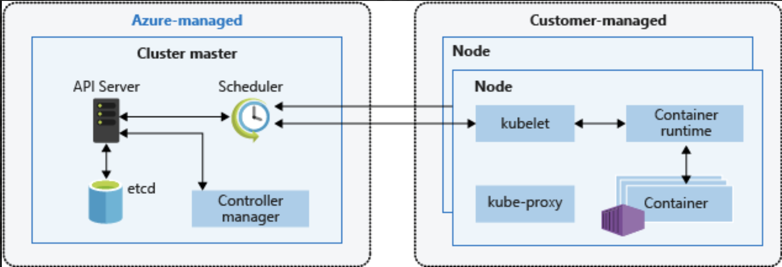
Common scenarios
Kubernetes Architecture

Slide 14
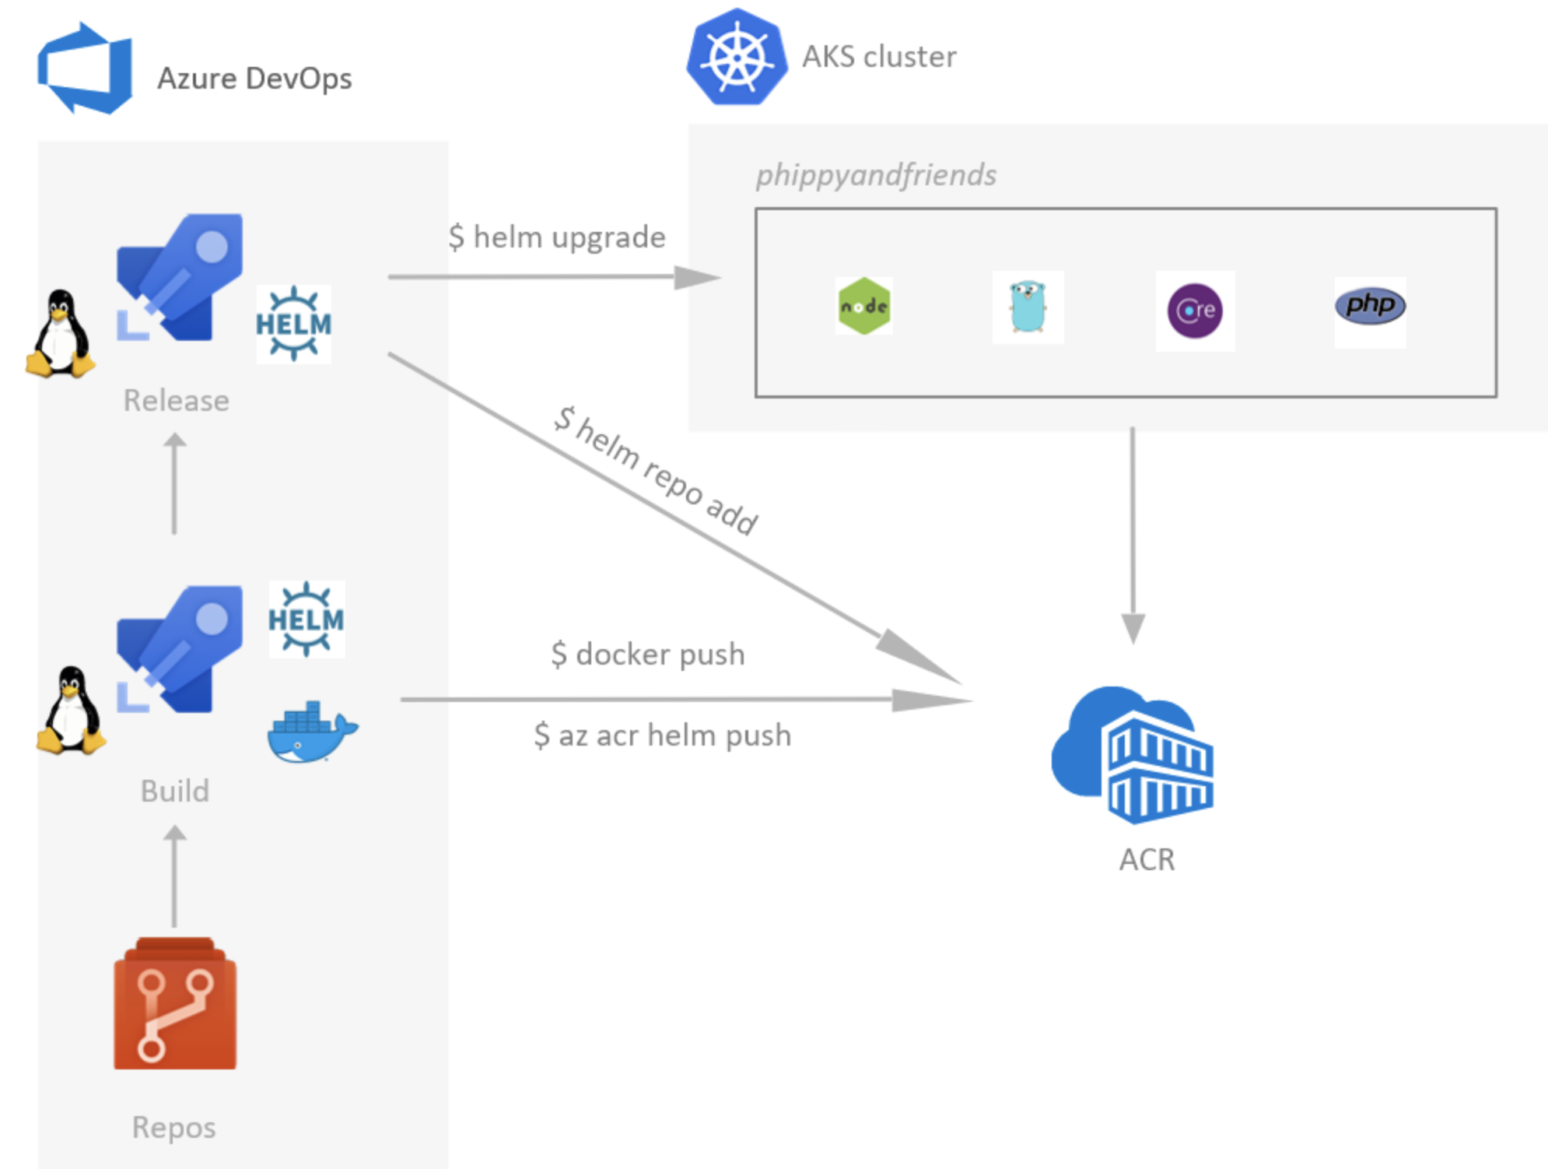
Common scenarios 2
Azure DevOps for CICD to Azure Kubernetes Service (AKS)

Slide 15
Step 2: Design the solution
Outcome
Design a solution and prepare to present the solution to the target customer audience in a 15-minute chalk-talk format.
Timeframe
60 minutes
Business needs (10 minutes) | Respond to questions outlined in your guide and be prepared to present your solutions to others.
Design (35 minutes) | Design a solution for as many of the stated requirements as time allows.
Prepare (15 minutes) | Identify any customer needs that are not addressed with the proposed solution. Identify the benefits of your solution. Determine how you will respond to the customer’s objections. Prepare for a 15-minute presentation to the customer.

Slide 16
Step 3: Present the solution
Outcome
Prepare to present a solution to the target customer in a 15-minute chalk-talk format.
Timeframe
30 minutes (15 minutes for each team to present and receive feedback)
Directions
Pair with another team.
One group is the Microsoft team, the other is the customer.
The Microsoft team presents their proposed solution to the customer.
The customer asks one of the objections from the list of objections in the case study.
The Microsoft team responds to the objection.
The customer team gives feedback to the Microsoft team.
Switch roles and repeat Steps 2-6.

Slide 17
Wrap-up
Outcome
Identify the preferred solution for the case study.
Identify solutions designed by other teams.
Timeframe
15 minutes

Slide 18

Preferred target audience
Arthur Block, VP Engineering at Fabrikam Medical Conferences
The primary audience is the technical strategic decision-maker with influential solution architects or lead technical personnel in development or operations .
Usually, we talk to the key architects, developers and infrastructure managers who report to the CIO or equivalent, or to key solution sponsors or those that represent the business unit IT or developers that report to those sponsors.
Notes:
The primary audience is the technical strategic decision-maker with influential solution architects or lead technical personnel in development or operations.
For this example, this could include the VP Engineering and his core team.

Slide 19
Preferred solution
After evaluating the options for container platforms on Azure, Fabrikam Medical Conferences decided to move forward with Azure Kubernetes Service (AKS).
They also decided to move forward with GitHub Actions for infrastructure and container DevOps workflows.

Slide 20
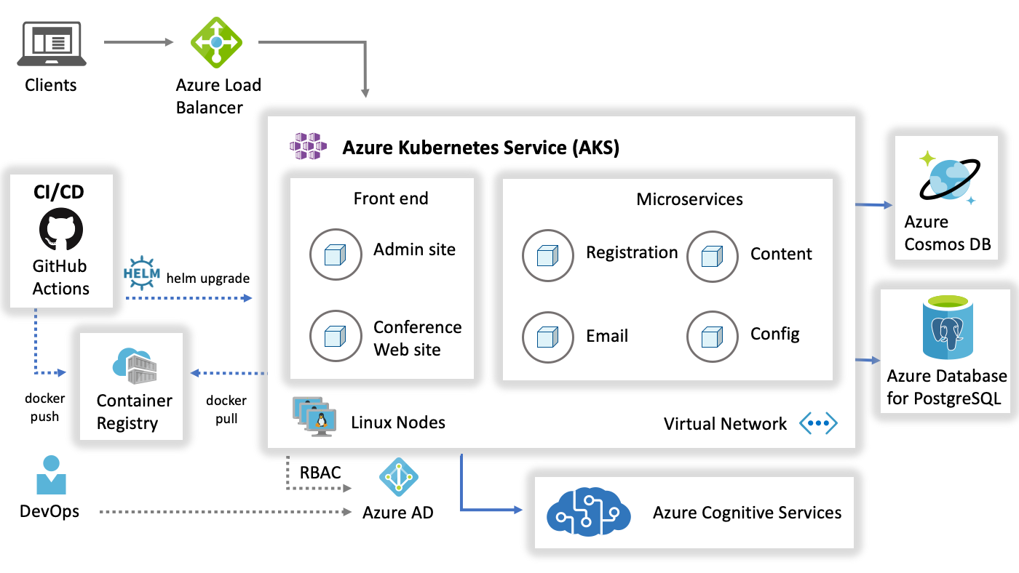
Preferred solution 2
Notes:
Reference Links:
https://docs.microsoft.com/en-us/azure/architecture/reference-architectures/microservices/aks

Slide 21
Preferred solution 3 – Multi-cloud Arc-enabled Services
Pros
Vendor independence and flexibility
Utilize vendor specific capabilities and features
Reduce vendor to customer geographic latency
Improve resilience to vendor failure
Cons
Single operational monitoring and reporting view
Increased complexity – licensing, managing costs, compliance, hiring staff, governance, SLA
Security – attack surface area, identity management
Notes:
Reference Links:
Single operational monitoring view – https://docs.microsoft.com/azure/azure-arc/kubernetes/overview
https://docs.microsoft.com/azure/defender-for-cloud/defender-for-containers-introduction?tabs=defender-for-container-arch-aks
https://docs.microsoft.com/azure/azure-arc/kubernetes/conceptual-cluster-connect
Azure Arc Jump Start - https://azurearcjumpstart.io/

Slide 22
Preferred objection handling
There are many ways to deploy Docker containers on Azure. How do those options compare and what are motivations for each?
Azure Kubernetes Services (AKS) – the ideal solution for a fully managed experience
Azure Container Instances – simple, isolated, without management tooling, enabling workload scale on demand
Web App for Containers – simple PaaS without full-featured container orchestration
Notes:
The easiest way to move to containers on Azure is to deploy containers to the Linux variant of App Service. However, this option does not provide a full-featured container orchestration platform with highly customizable load balancing, dynamic service discovery, and a holistic approach to container monitoring.
Azure Container Instances also provide a simple way to manage individual containers without management tooling providing a way to do on demand scaling for workloads that need that flexibility.
Ideally, Azure Kubernetes Service (AKS) will provide a fully managed service with the full set of orchestration and management tools. Working with AKS is the best choice to enable migration to AKS while still benefiting from a complete container orchestration experience to support the growth trajectory of the solution.

Slide 23
Preferred objection handling 2
Is there an option in Azure that provides container orchestration platform features that are easy to manage and migrate to, that can also handle our scale and management workflow requirements?
The best option is to go with a managed cluster such as Azure Kubernetes Service (AKS), native to Azure
Notes:
The best of all worlds is to go with a managed orchestration platform like AKS – native to Azure. It reduces the cost and management overhead of the cluster, while still providing a solution that supports growth, scale, and native management tooling.
With Kubernetes, you will have additional features at your fingertips beyond the pure Docker approach including:
The Kubernetes management dashboard which includes the web interface and remote APIs for managing, running, and scaling containers, including CICD integration options.
The kubectl command line tool for engaging remote Kubernetes APIs and assisting with automation.
Built-in dynamic service discovery simplifying the deployment of new container instances to a load balanced environment.

Slide 24
Preferred objection handling 3
We heard Azure Cosmos DB is compatible with MongoDB. Will this provide a migration that minimized code changes?
Azure Cosmos DB supports multiple NoSQL data models; including supporting a MongoDB API. This provides compatibility for code written for MongoDB to communicate with Cosmos DB without code changes; for easier migration and interoperability.

Slide 25
Preferred objection handling 4
We know Microsoft offers Cognitive Services with pre-built AI models. What models offer the features we are looking to use for enhancing our conference web site?
Azure Cognitive Services brings AI within reach for every developer - without requiring machine-learning expertise. All it takes is an API call to embed the ability to implement ML models managed by Microsoft.
Content Moderator API can be used to add machine-assisted content moderation and human review tools for images, text, and videos. You can enhance your ability to detect potentially offensive or unwanted images through machine learning-based classifiers, custom lists, and optical character recognition (OCR).
Translator API can be used to integrate an AI service for real-time text translation. It can translate text in real-time across more than 70 languages.

Slide 26
Customer quote
“With Azure Kubernetes Service (AKS) and Cosmos DB we feel confident we can make the move to a cloud-native, container-based platform with the right DevOps support in place to be successful with a small team.”
- Arthur Block, VP of Engineering at Fabrikam Medical Conferences

